Slide 1
Case Study:VoltEdge-Electronics
Business Performance Analysis

Slide 2
VoltEdge Electronics – Business Overview
VoltEdge Electronics is a fast-growing, U.S.-based retail chain specializing in consumer electronics.
With over 20 stores nationwide and a growing e-commerce presence, VoltEdge serves a broad customer base—from college students to working professionals—by offering a wide range of products at competitive prices.
VoltEdge follows a dual strategy:
Retailing products from major global brands such as Apple, Sony, Lenovo, Dell, and Samsung.
Manufacturing and selling its own branded products under the VoltEdge name, focusing on affordability, functional design, and reliability.
You have been assigned to analyze VoltEdge's data collected over the last 2 years and give recommendations for their business questions.

Slide 3
Question 1: Data Pre-Processing
Enlist the preprocessing and data refinement steps you performed. Note key observations/assumptions.
Using the tabs in the excel data file provided, mention the data columns and keys (primary/secondary/foreign keys) that you observe across the databases.
Table | Primary Key | Foreign Keys
1. Product Sales Data | (None) | StoreID, Product Code
2. Stores Details | Store ID | (None)
3. Product Details | Product Code | (None)
4. Customer Level Data | CustomerID | Store Visited

Slide 4
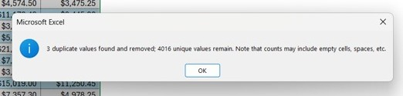
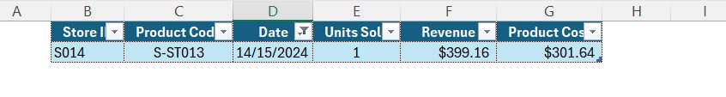


Question 1: Data Pre-Processing
Enlist the preprocessing and data refinement steps you performed. Note key observations/assumptions.
Input Validation –
Before starting your analysis, what are the sanity checks that you will apply?
1) Checked for Duplicate Values and found 3 duplicate values in 1. Product Sales Data table.
2) 1 row with incorrect Units Sold column format (i.e. ###) was removed.
3) Replaced ‘-’ values from Store Details as blank values.
Replaced ‘-’ values from Mean Time between orders as NaN values.
Are there any data columns that contain incorrect data formats or entries?
1) We found 1 incorrect date entry and removed it.
2) Changed date format of Inactive Date column of 2. Store Details table and Date column of 1. Product Sales Data table as
yyyy-mm-dd
Are there any stores in the sales data that are inactive?
No there were no stores in sales data that are inactive.

Slide 5

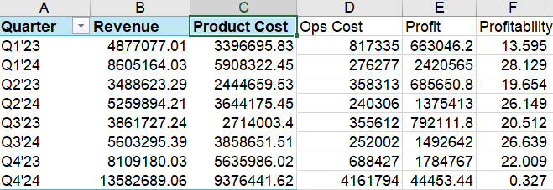
Question 2: National Business Performance Overview
Populate the following tables and create graphs for National Revenue and Profits. (Profit = Revenue – Product Cost – Cost of Operations (during relevant timeframe)) (Profitability = Profit/Revenue)

Slide 6
Question 2: National Business Performance Overview
Populate the following tables and create graphs for National Revenue and Profits. (Profit = Revenue – Product Cost – Cost of Operations (during relevant timeframe)) (Profitability = Profit/Revenue)
Comment on the trends observed in the above tables.
Here’s a strong increase in revenue from 2023 to 2024 — going from about ₹20.3 million to ₹33 million.
That’s a big leap and shows the business is growing well in terms of sales.
But here’s the catch: profitability has actually dropped (from 19.3% to 16.1%).
So even though we’re earning more, we’re not keeping as much of it as profit. That means costs have gone up too — either product costs or
operational expenses.
Looking quarter by quarter:
Q1’24 did very well — both high revenue and excellent profitability (28.1%).
Q4’24 had the highest revenue ever, but profit margins completely collapsed to just 0.3%, meaning costs probably spiked big time.
Overall, the business is scaling up, but needs better cost control, especially during high-revenue periods.

Slide 7
Question 2: National Business Performance Overview
Populate the following tables and create graphs for National Revenue and Profits. (Profit = Revenue – Product Cost – Cost of Operations (during relevant timeframe)) (Profitability = Profit/Revenue)
What are the possible hypotheses for the YoY and QoQ trends observed?
Year-over-Year:
Maybe we opened more stores or launched new products in 2024 — that would explain the higher revenue.
But rising costs (maybe in logistics, supply chain, or marketing) are eating into profits.
Discounts or lower-margin product sales could also be a factor.
Quarter-over-Quarter:
Big jump in Q1'24 could be from New Year sales or a successful launch campaign.
Q4'24’s strange case — super high sales but almost no profit — might mean:
Massive discounting or clearance sales.
Unexpected costs like high returns or overspending in operations.
Or perhaps stocking up inventory or vendor payment issues.

Slide 8
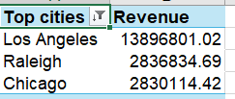
Question 2: National Business Performance Overview
Populate the following tables and create graphs for National Revenue and Profits. (Profit = Revenue – Product Cost – Cost of Operations (during relevant timeframe)) (Profitability = Profit/Revenue)
Mention top 3 cities that are bringing the most revenue.

Slide 9
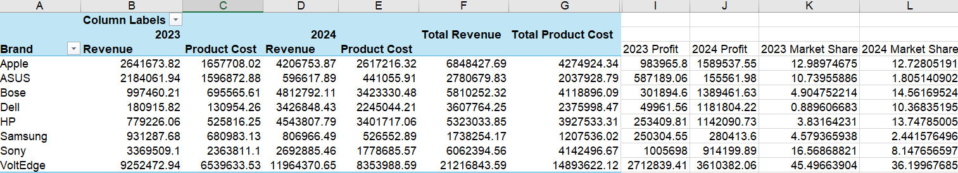
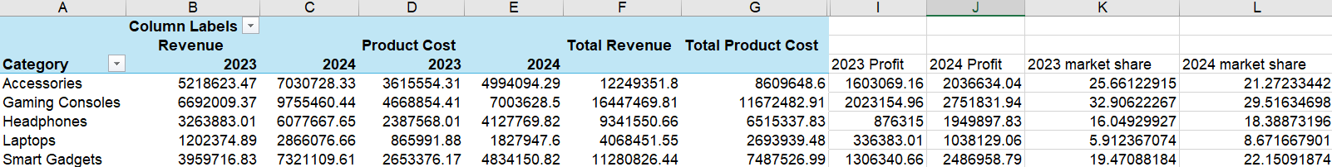
Question 3: Business Performance Overview
Populate the following tables to understand profits from each product category

Slide 10
Question 3: Business Performance Overview
Populate the following tables to understand profits from each product category
Share insights based on the above tables.
Revenue has grown across all product categories and most brands from 2023 to 2024, showing strong
business momentum.
Among product categories, Smart Gadgets and Gaming Consoles stand out:
Both categories saw significant increases in profit and market share.
Smart Gadgets' profit nearly doubled, and its market share grew from 19.47% to 22.15%.
Laptops continue to generate the highest overall revenue, but their market share has slightly declined
and profit margins are lower compared to other categories.
Looking at brands, most have seen modest growth. However, ASUS and Sony experienced noticeable
declines in their 2024 market share, which could point to increasing competition or a reduced focus on sales.

Slide 11
Question 3: Business Performance Overview
Populate the following tables to understand profits from each product category
How are VoltEdge products performing in comparison to other brands?
VoltEdge is the top-performing brand in terms of revenue, profit, and market dominance:
It has the highest total revenue across both years, crossing ₹21 million.
Profitability remains strong, with profits increasing from ₹2.71 million in 2023 to ₹3.61 million in 2024.
It also leads in market share, with 45.5% in 2023 and 36.2% in 2024.
Despite this leadership, its market share has declined, suggesting that competitors like Bose, Dell, or Apple
may be closing the gap or that VoltEdge’s sales growth has slowed compared to the rest of the market.

Slide 12
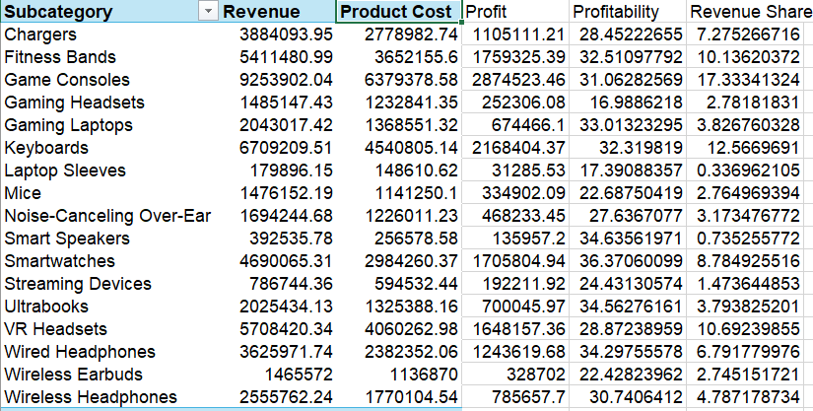
Question 4: Subcategory Deep dives
Populate the following table and plot the subcategory of products on the scatter plot
Revenue Share to be calculated with respect to all 17 subcategories.

Slide 13
Question 4: Subcategory Deep dives
Populate the following table and plot the subcategory of products on the scatter plot
Revenue Share to be calculated with respect to all 17 subcategories.
Interpret the graph and recommend some actionable insights for the Store Managers based on the 4 quadrants.
Quadrant I – High Revenue & High Profitability
Top-performing products – high sales and strong margins.
Subcategories:
Smartwatches, Fitness Bands, Wired Headphones, Keyboards
Action:
Keep well-stocked, promote heavily, bundle with other items.
Quadrant II – Low Revenue & High Profitability
Profitable but underexposed – need push.
Subcategories:
Ultrabooks, Smart Speakers
Action:
Improve visibility, staff pitching, use in combos.

Slide 14
Question 4: Subcategory Deep dives
Populate the following table and plot the subcategory of products on the scatter plot
Revenue Share to be calculated with respect to all 17 subcategories.
Interpret the graph and recommend some actionable insights for the Store Managers based on the 4 quadrants.
Quadrant III – Low Revenue & Low Profitability
Underperformers – low sales, low margins.
Subcategories:
Laptop Sleeves, Streaming Devices, Gaming Headsets, Mice, Noise-Canceling Over-Ear, Wireless Earbuds
Action:
Reduce SKUs, de-prioritize space, consider phasing out.
Quadrant IV – High Revenue & Low Profitability
High sales, low margin – needs cost control.
Subcategories:
Game Consoles, Chargers, VR Headsets, Wireless Headphones
Action:
Negotiate costs, promote premium versions, avoid discounts.

Slide 15
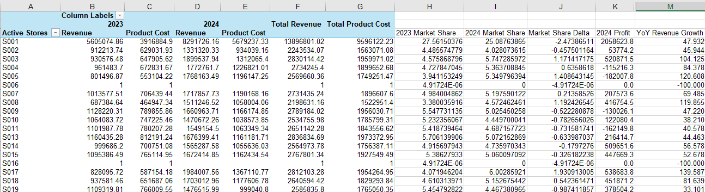
Question 5.1: Store Performance Review
Assess the store level performance using the table below.

Slide 16
Question 5.1: Store Performance Review
Assess the store level performance using the table below.
Share insights on the top and bottom performing stores.
Top Performing Stores
S017: Highest profit (₹538.7K) and strong market share gain (+1.93%). A clear leader in growth and profitability.
S003: High profit (₹520.9K) with a 1.17% increase in market share. Solid performance across the board.
S019: Consistent profit (₹378.5K) despite a slight dip in market share (–0.99%).
Bottom Performing Stores
S005: Worst loss (–₹1.15M). High cost overruns despite steady revenue.
S006: No profit and biggest market share drop (–4.91%). Needs immediate attention.
S008: Loss of ₹416.7K and market share drop (–1.19%). Operational challenges evident.
Key Insights
Stores like S017 and S003 are scaling efficiently with both profit and market share growth.
S005 and S006 are under major pressure due to high costs or declining presence.
Strategic focus is needed on bottom performers to improve efficiency and competitiveness.

Slide 17
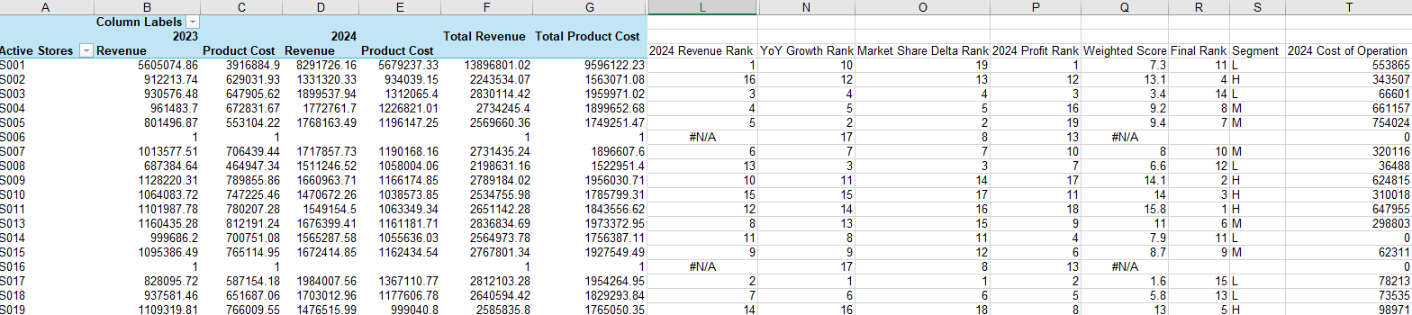
Question 5.2: Store Performance Review
Create individual rankings for each of the metrics calculated in 5.1. Create a weighted score using the weights indicated in brackets. Create a final ranking based on the weighted score. (Hint: weighted score calculated by multiplying metric ranks with weights and summing them)
1. 2024 Revenue (20%)
2. % YoY Revenue growth (2023 vs 2024) (10%)
3. 2023 to 2024 Market Share Delta (40%)
4. 2024 Profit (30%)

Slide 18
Question 5.2: Store Performance Review
Create individual rankings for each of the metrics calculated in 5.1. Create a weighted score using the weights indicated in brackets. Create a final ranking based on the weighted score. (Hint: weighted score calculated by multiplying metric ranks with weights and summing them)
1. 2024 Revenue (20%)
2. % YoY Revenue growth (2023 vs 2024) (10%)
3. 2023 to 2024 Market Share Delta (40%)
4. 2024 Profit (30%)
Based on the 2024 Profit and Cost of Operation, which one of the above stores should be closed down?
🔹 Calculation of Net Profit (2024)
Net Profit = Revenue – Product Cost – Cost of Operation
For Store S014:
2024 Revenue = ₹1,056,524.34
2024 Product Cost = ₹990,081.60
2024 Cost of Operation = ₹91,700
Net Profit = 1,056,524.34 – 990,081.60 – 91,700 = –₹25,257.26 (Loss)
Despite generating revenue, the combined cost of products and operations exceeds earnings, making it financially unsustainable.
Other stores have lower revenue but still manage to stay profitable due to better cost management.
It is the only store running at a net loss in 2024.

Slide 19
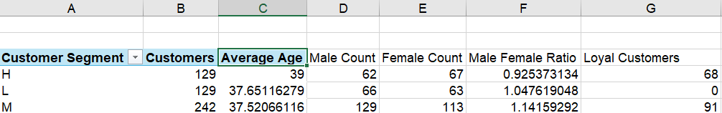
Question 6: Demographics
You have been provided data for customers who have shown interest in a promotional offer campaign.
What is the average age and gender split in each customer segment? Also, calculate and populate the number of loyal customers. (Loyalty = Customers who visited more than 4 times & MTBO < 2.5 months)

Slide 20
Question 6: Demographics
You have been provided data for customers who have shown interest in a promotional offer campaign.
What is the average age and gender split in each customer segment? Also, calculate and populate the number of loyal customers. (Loyalty = Customers who visited more than 4 times & MTBO < 2.5 months)
What are the top 3 most popular product subcategories in the High segment?
Customer counts in High segment:
VoltEdge – 129
Sony – 99
HP – 93
Answer: VoltEdge, Sony, HP
What is the Penetration of VoltEdge Brand within each segment? (Customer% of total customers within segment)
High Segment: 17.94%
Low Segment: 25.25%
Medium Segment: 19.04%

Slide 21
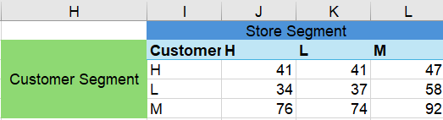
Question 7:
Populate the following cross tab by calculating the number of customers within each customer and store segment
What are the top 3 stores with the most Loyalty rate?
S017 – 42.4%
S008 – 38.7%
S005 – 38.1%

